Slide 1


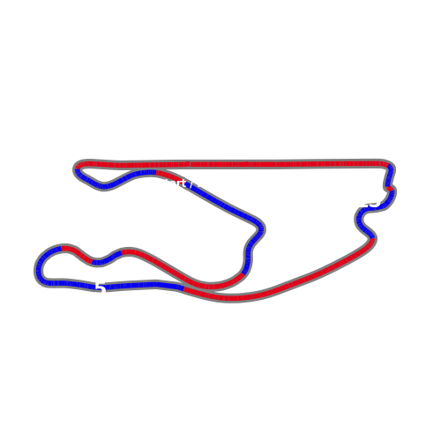


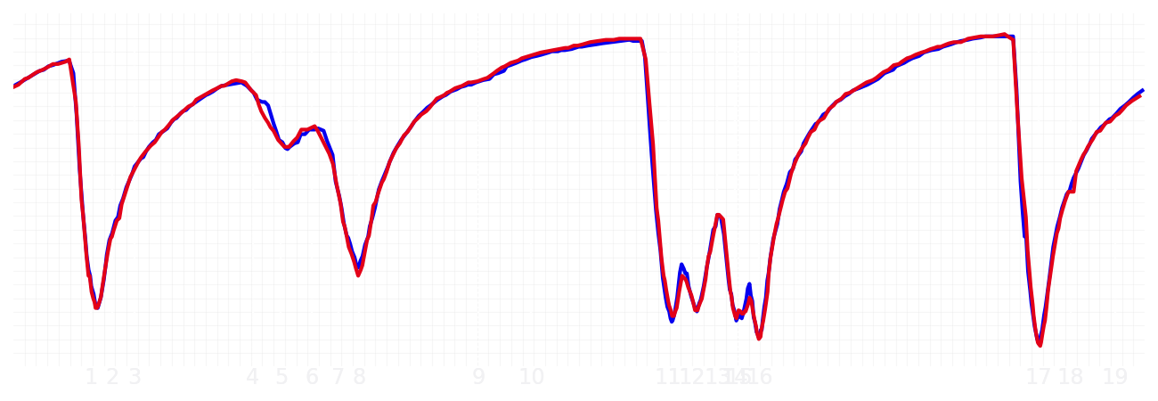
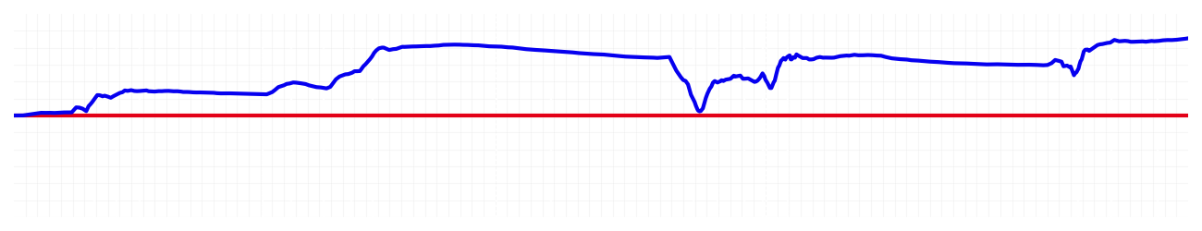
Miami GP Qualifying Q2
Max Verstappen
Driver
Yuki Tsunoda
Driver
Lap Time
01:26.643
01:26.959
Lap Time
Sector 1
28.345
Speed Trap 1
223 kp/h
Speed Trap 1
221 kp/h
Sector 1
28.603
Sector 2
33.309
Speed Trap 2
191 kp/h
Gap
-0.316
Gap
0.316
Speed Trap 2
191 kp/h
Sector 2
33.318
Sector 3
24.989
Speed Final Line
286 kp/h
Corner Advantage
6/20
Corner Advantage
14/20
Speed Final Line
282 kp/h
Sector 3
25.038
FULL THROTTLE
60%
60%
FULL THROTTLE
HEAVY BREAKING
18%
16%
HEAVY BREAKING
%LAP TIME
CORNERING
22%
24%
CORNERING
%LAP TIME
SPEED
SPEED
DELTA TIME
DELTA TIME

Slide 2

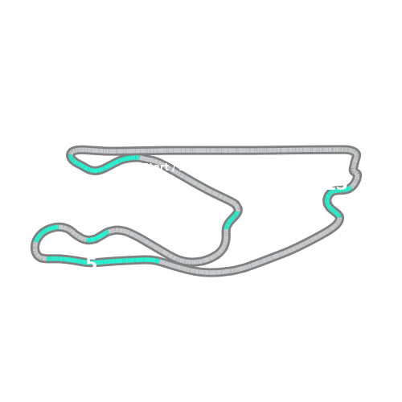


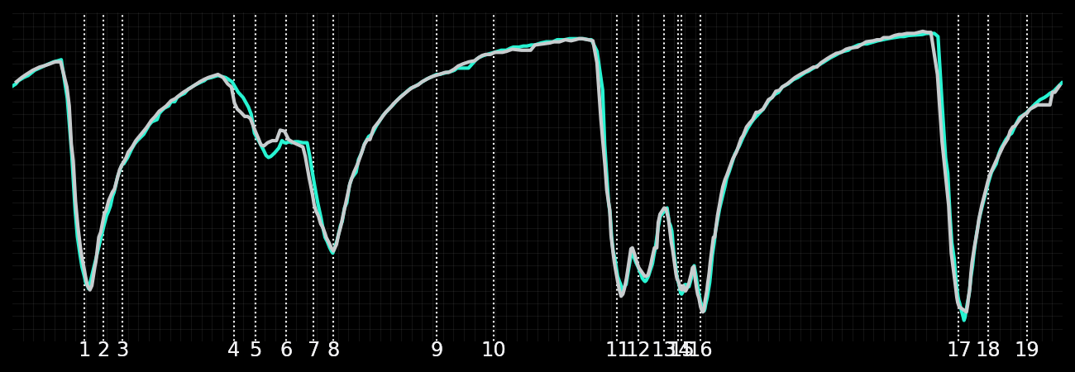
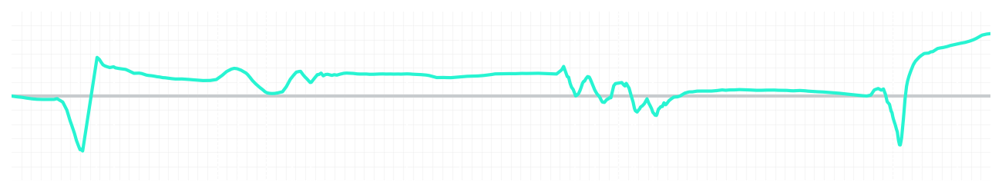
Miami GP Qualifying Q2
Kimi Antonelli
Driver
George Russell
Driver
Lap Time
01:26.606
01:26.575
Lap Time
Sector 1
28.552
Speed Trap 1
222 kp/h
Speed Trap 1
224 kp/h
Sector 1
28.510
Sector 2
33.218
Speed Trap 2
191 kp/h
Gap
0.031
Gap
-0.031
Speed Trap 2
193 kp/h
Sector 2
33.278
Sector 3
24.836
Speed Final Line
285 kp/h
Corner Advantage
20/20
Corner Advantage
0/20
Speed Final Line
285 kp/h
Sector 3
24.787
FULL THROTTLE
59%
0%
FULL THROTTLE
HEAVY BREAKING
17%
0%
HEAVY BREAKING
%LAP TIME
CORNERING
24%
100%
CORNERING
%LAP TIME
SPEED
SPEED
DELTA TIME
DELTA TIME

Slide 3

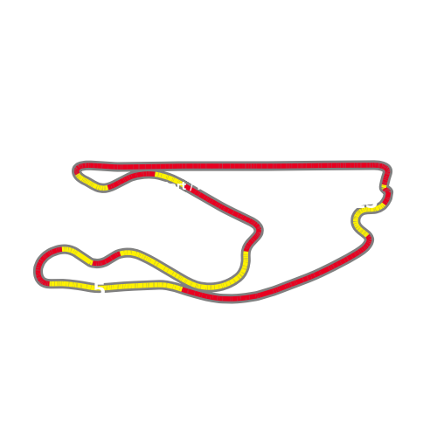


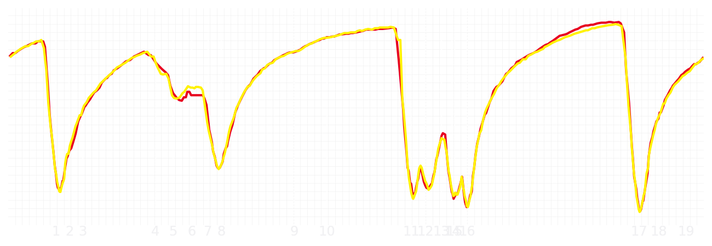
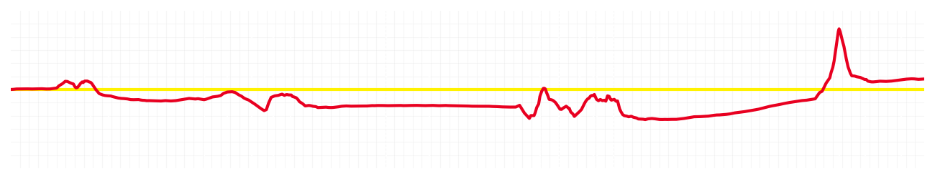
Miami GP Qualifying Q2
Charles Leclerc
Driver
Lewis Hamilton
Driver
Lap Time
01:26.948
01:27.006
Lap Time
Sector 1
28.919
Speed Trap 1
224 kp/h
Speed Trap 1
223 kp/h
Sector 1
28.759
Sector 2
33.303
Speed Trap 2
192 kp/h
Gap
-0.058
Gap
0.058
Speed Trap 2
192 kp/h
Sector 2
33.302
Sector 3
24.726
Speed Final Line
287 kp/h
Corner Advantage
8/20
Corner Advantage
12/20
Speed Final Line
287 kp/h
Sector 3
24.945
FULL THROTTLE
58%
58%
FULL THROTTLE
HEAVY BREAKING
17%
19%
HEAVY BREAKING
%LAP TIME
CORNERING
25%
23%
CORNERING
%LAP TIME
SPEED
SPEED
DELTA TIME
DELTA TIME

Slide 4

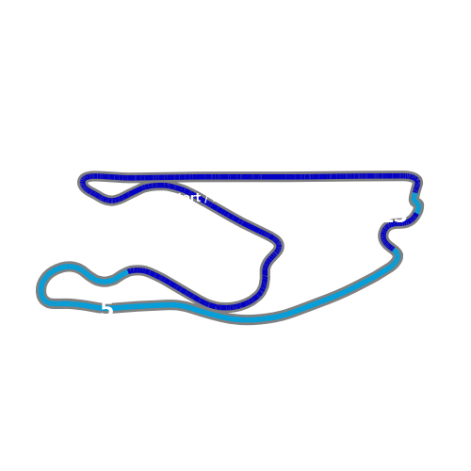


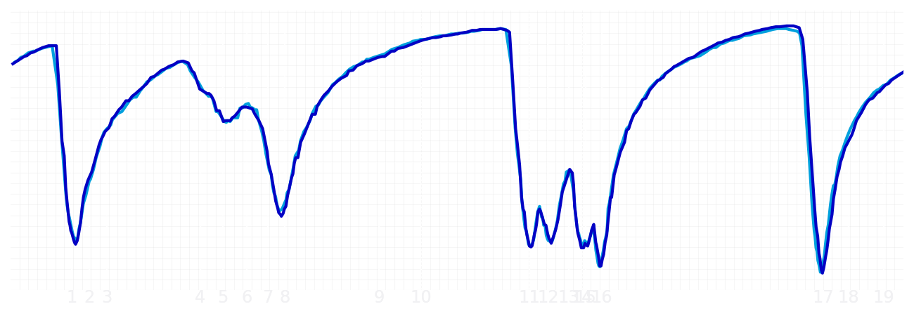
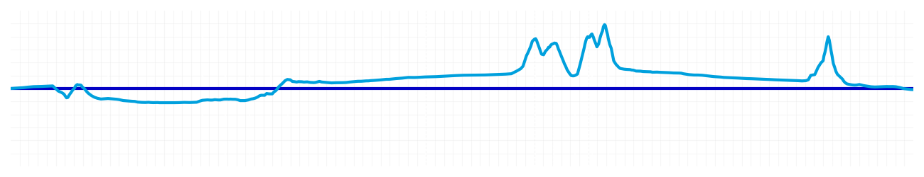
Miami GP Qualifying Q2
Alexander Albon
Driver
Carlos Sainz
Driver
Lap Time
01:26.855
01:26.847
Lap Time
Sector 1
28.779
Speed Trap 1
224 kp/h
Speed Trap 1
223 kp/h
Sector 1
28.803
Sector 2
33.225
Speed Trap 2
192 kp/h
Gap
0.008
Gap
-0.008
Speed Trap 2
192 kp/h
Sector 2
33.277
Sector 3
24.851
Speed Final Line
284 kp/h
Corner Advantage
11/20
Corner Advantage
9/20
Speed Final Line
286 kp/h
Sector 3
24.767
FULL THROTTLE
55%
58%
FULL THROTTLE
HEAVY BREAKING
19%
20%
HEAVY BREAKING
%LAP TIME
CORNERING
26%
22%
CORNERING
%LAP TIME
SPEED
SPEED
DELTA TIME
DELTA TIME

Slide 5

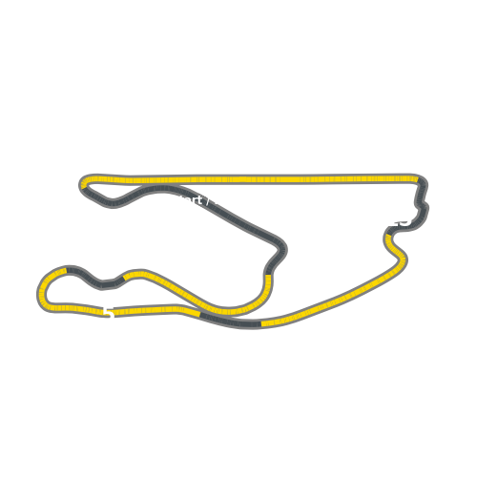


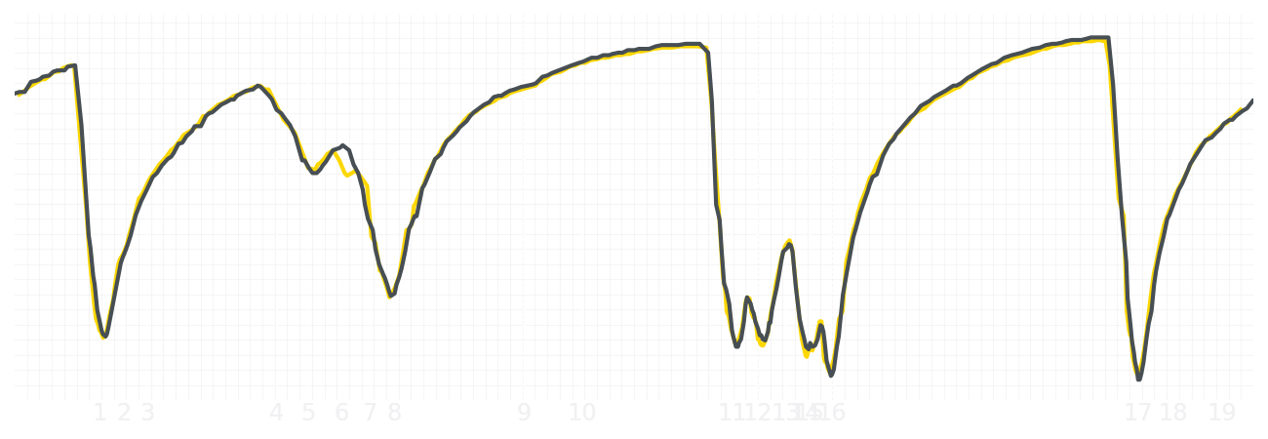
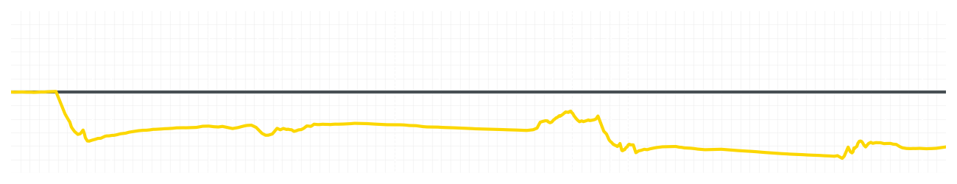
Miami GP Qualifying Q2
Liam Lawson
Driver
Isack Hadjar
Driver
Lap Time
01:27.363
01:26.987
Lap Time
Sector 1
28.855
Speed Trap 1
221 kp/h
Speed Trap 1
221 kp/h
Sector 1
28.705
Sector 2
33.557
Speed Trap 2
191 kp/h
Gap
0.376
Gap
-0.376
Speed Trap 2
192 kp/h
Sector 2
33.422
Sector 3
24.951
Speed Final Line
284 kp/h
Corner Advantage
11/20
Corner Advantage
9/20
Speed Final Line
284 kp/h
Sector 3
24.860
FULL THROTTLE
62%
60%
FULL THROTTLE
HEAVY BREAKING
15%
16%
HEAVY BREAKING
%LAP TIME
CORNERING
23%
24%
CORNERING
%LAP TIME
SPEED
SPEED
DELTA TIME
DELTA TIME

Slide 6

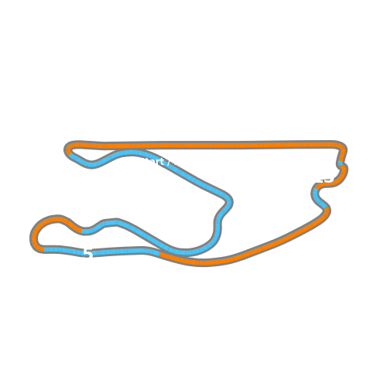


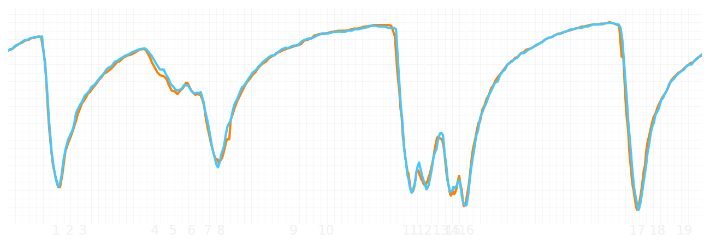
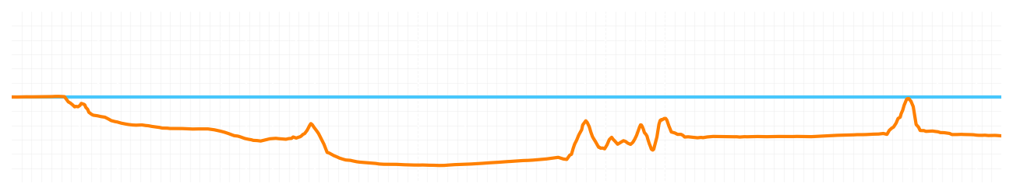
Miami GP Qualifying Q2
Lando Norris
Driver
Oscar Piastri
Driver
Lap Time
01:26.499
01:26.269
Lap Time
Sector 1
28.731
Speed Trap 1
221 kp/h
Speed Trap 1
226 kp/h
Sector 1
28.413
Sector 2
32.985
Speed Trap 2
194 kp/h
Gap
0.23
Gap
-0.23
Speed Trap 2
192 kp/h
Sector 2
33.032
Sector 3
24.783
Speed Final Line
285 kp/h
Corner Advantage
11/20
Corner Advantage
9/20
Speed Final Line
286 kp/h
Sector 3
24.824
FULL THROTTLE
57%
61%
FULL THROTTLE
HEAVY BREAKING
16%
16%
HEAVY BREAKING
%LAP TIME
CORNERING
27%
23%
CORNERING
%LAP TIME
SPEED
SPEED
DELTA TIME
DELTA TIME

